Slide 1
Visualizing Significant Gene Expression Change During CaLCuV Infection
Warda Arman & Tami Coursey

Slide 2
Objective
To visualize microarray data; specifically as a volcano plot¶

Slide 3
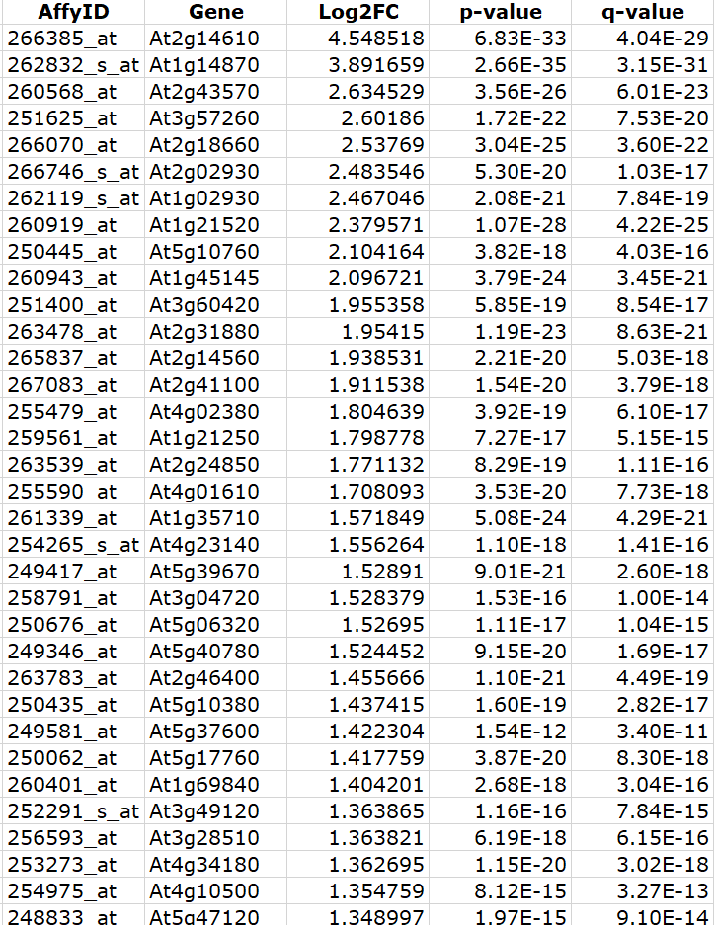
Data that was used
A portion of the data that was used
Reference:
https://www.ncbi.nlm.nih.gov/pmc/articles/PMC2528102/bin/pp.108.121038_index.html

Slide 4
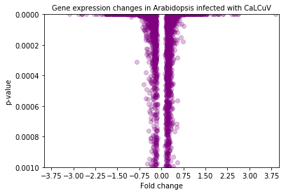
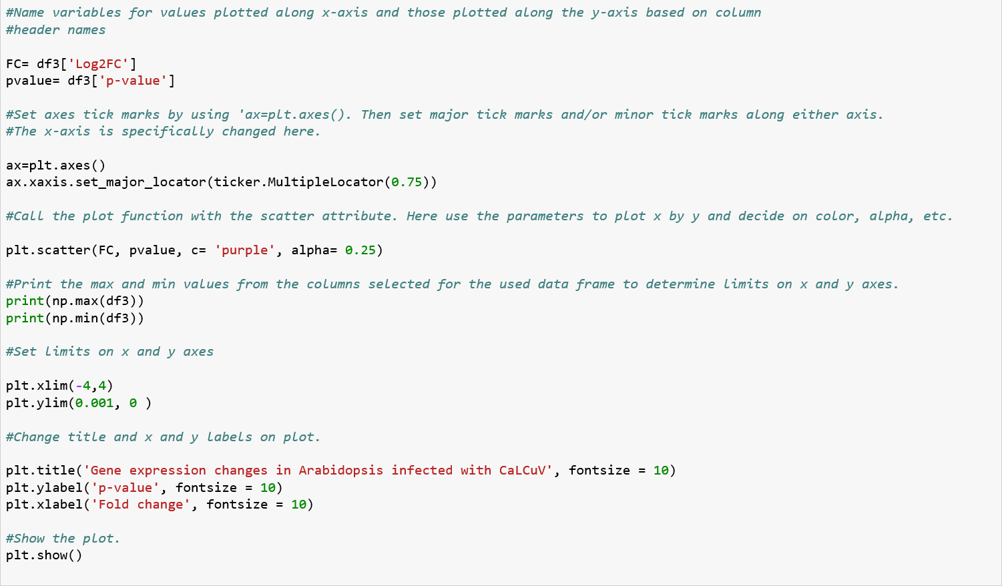
Results

